Slide 1
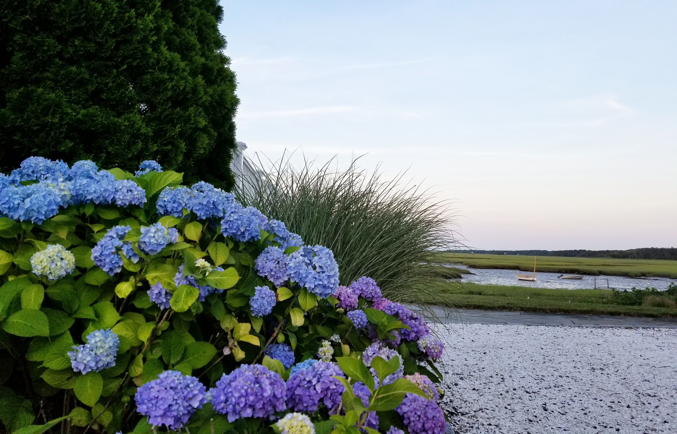
Osterville Garden Club
2023

Slide 2
Tina Sweeney

Slide 3
Tina Sweeney

Slide 4
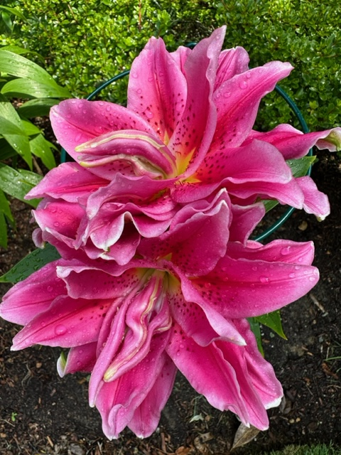
Tina Sweeney

Slide 5
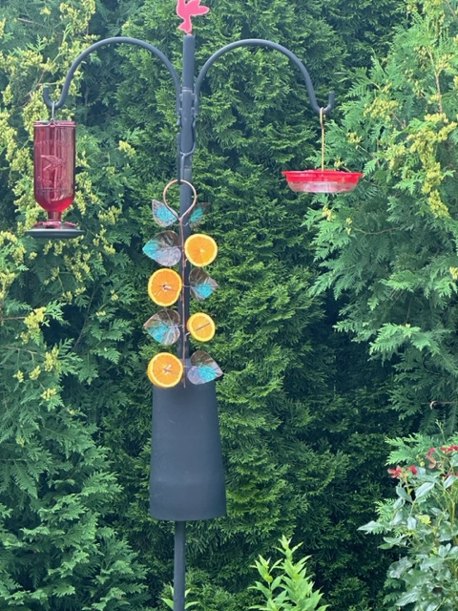
Tina Sweeney

Slide 6
Tina Sweeney

Slide 7
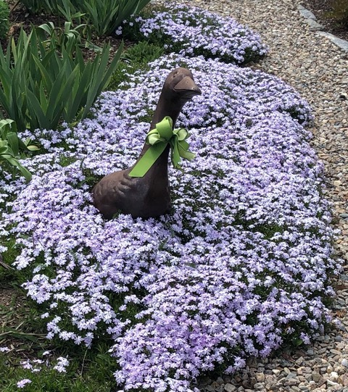
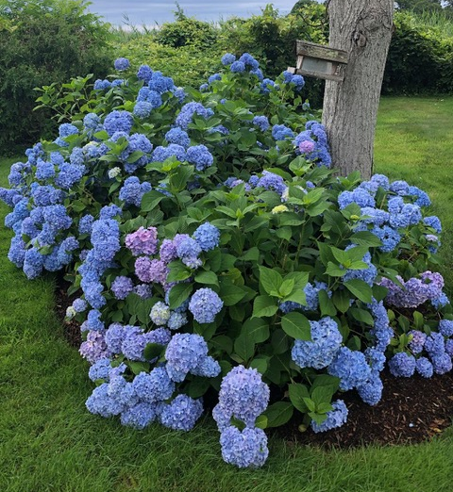
Carol Trifone
Notes:
Creeping/phlox/Hydrangeas/Carol Trifone

Slide 8
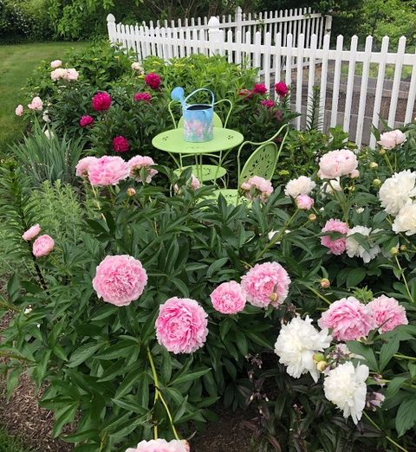
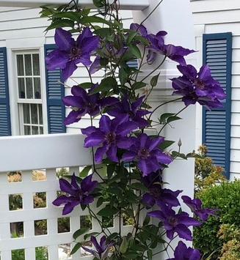
Carol Trifone
Notes:
Peonies/Clematis/Carol Trifone

Slide 9
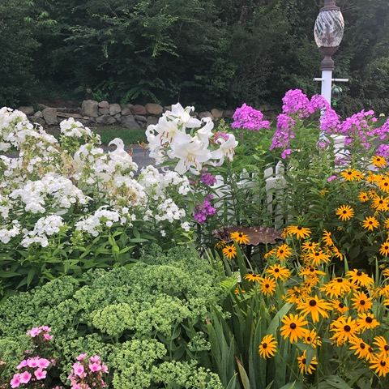
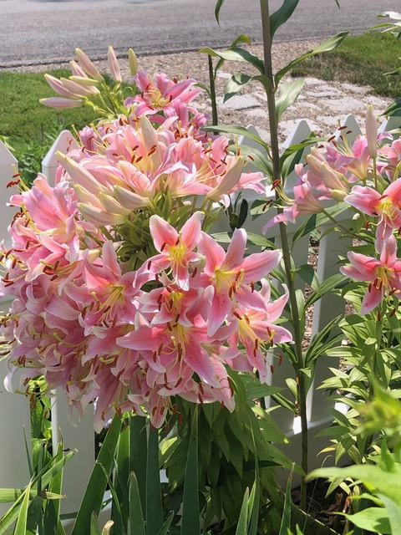
Carol Trifone
Notes:
Carol Trifone

Slide 10
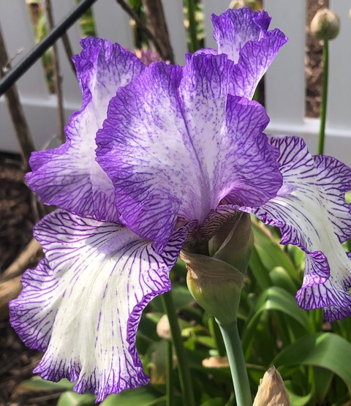
Carol Trifone
Notes:
Bearded Iris Carol Trifone

Slide 11
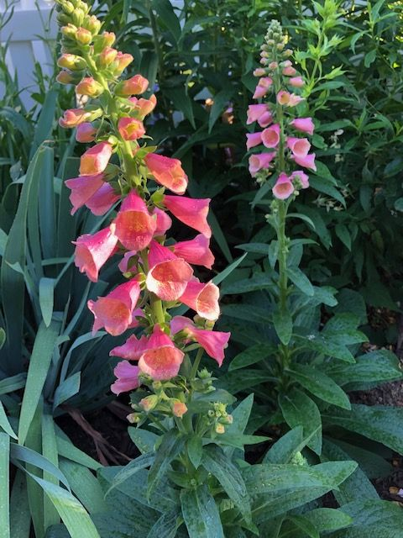
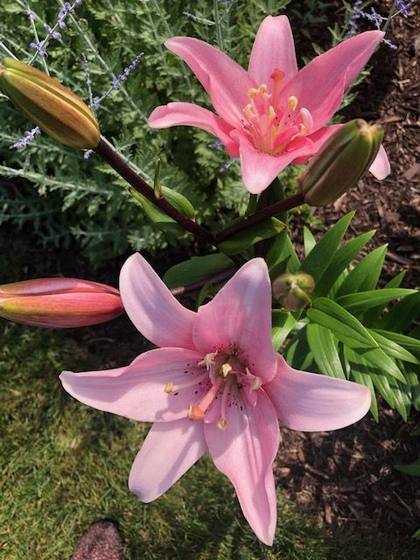
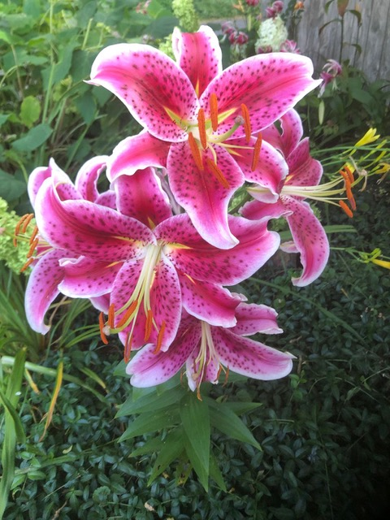
Carol Trifone
Notes:
Asiatic Lilys/Foxglove/Carol Trifone

Slide 12
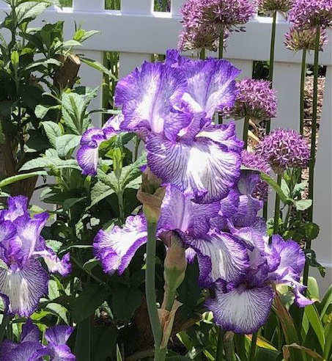
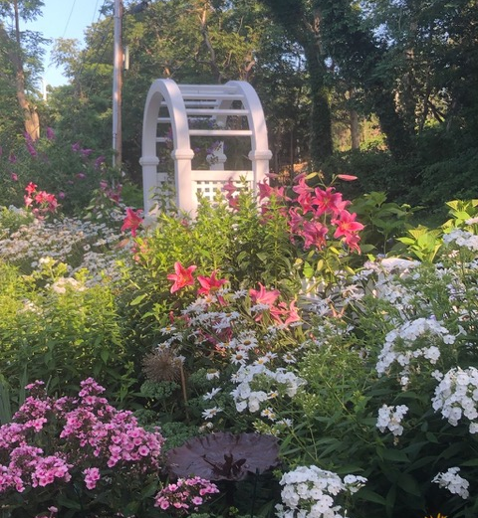
Carol Trifone
Notes:
Carol Trifone

Slide 13
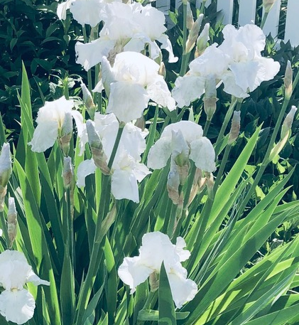
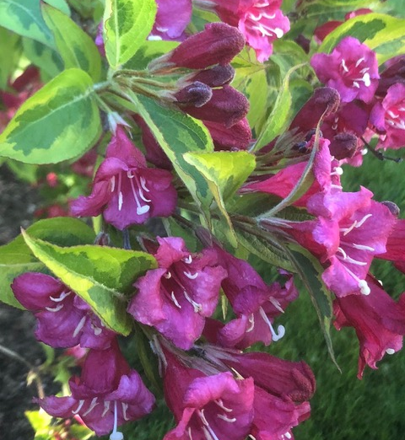
Carol Trifone
Notes:
Bearded Iris/Weigelia/Carol Trifone

Slide 14
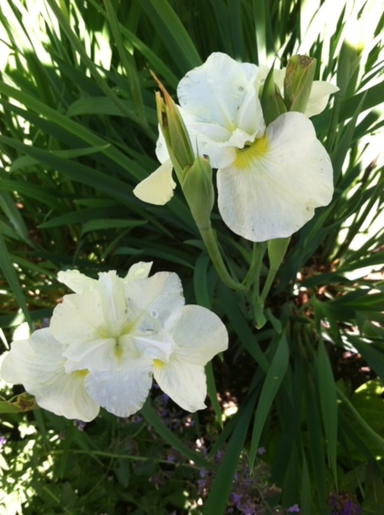
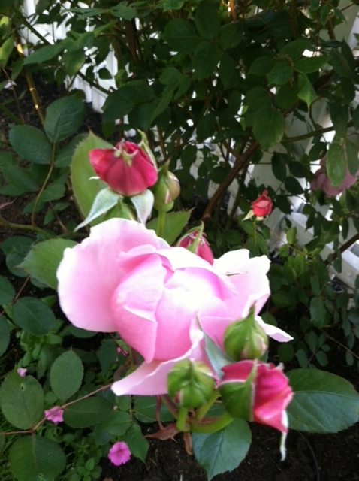
Karen Pinard
Notes:
Knock out Rose Karen Pinard

Slide 15
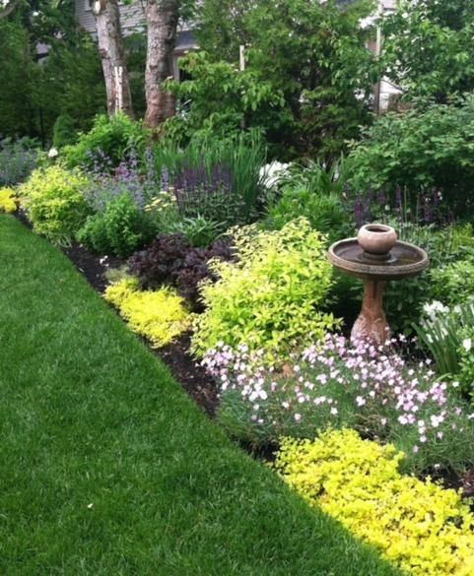
Karen Pinard
Notes:
Karen Pinard

Slide 16
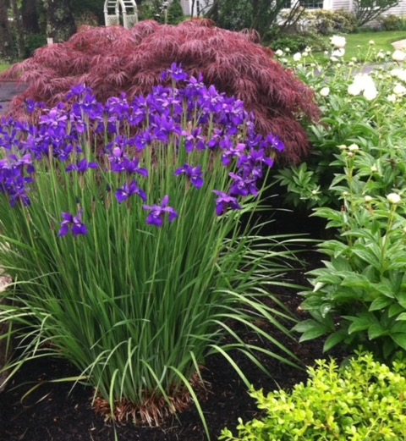
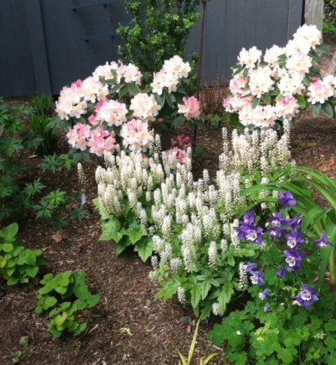
Karen Pinard
Notes:
Karen Pinard

Slide 17
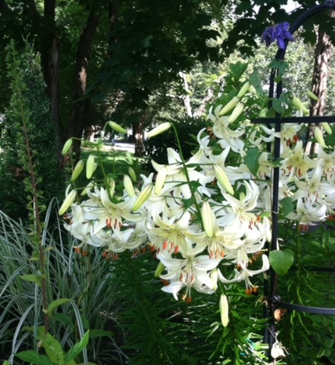
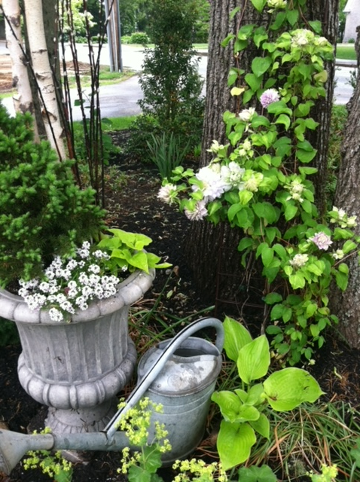
Karen Pinard
Notes:
Karen Pinard

Slide 18
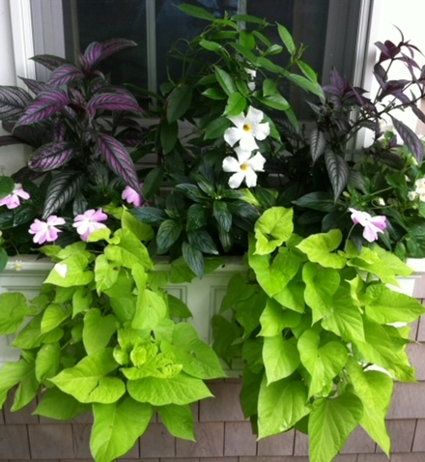
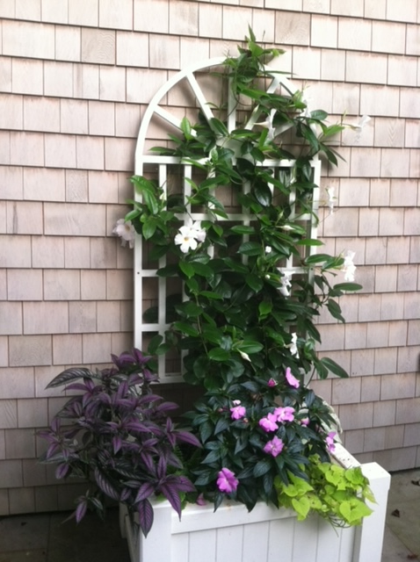
Karen Pinard
Notes:
Karen Pinard

Slide 19
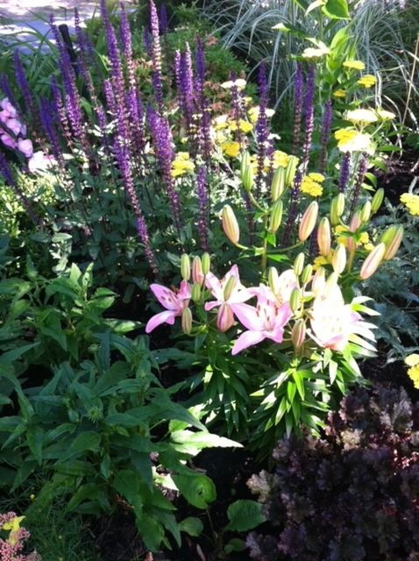
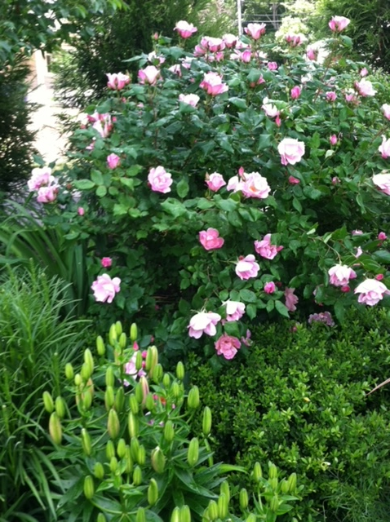
Karen Pinard
Notes:
Karen Pinard

Slide 20
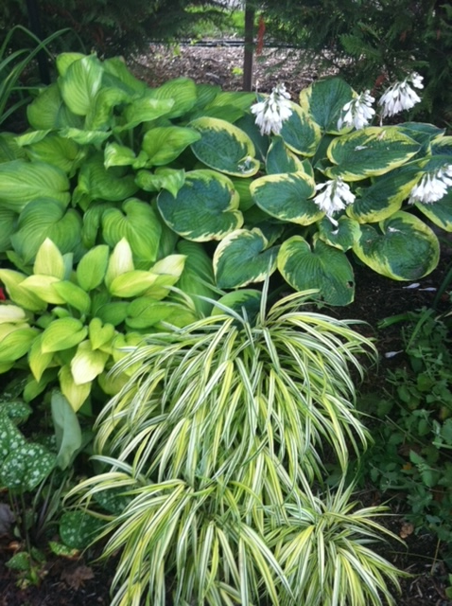
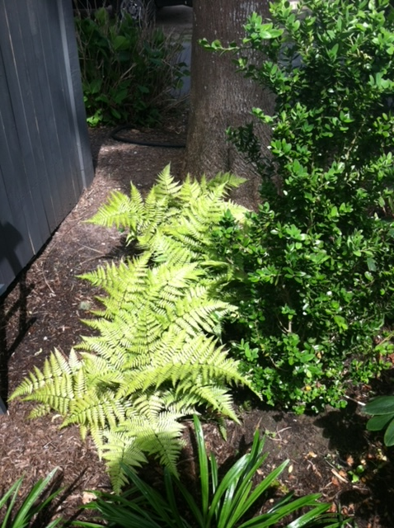
Karen Pinard
Notes:
Brights in the shade Karen Pinard

Slide 21
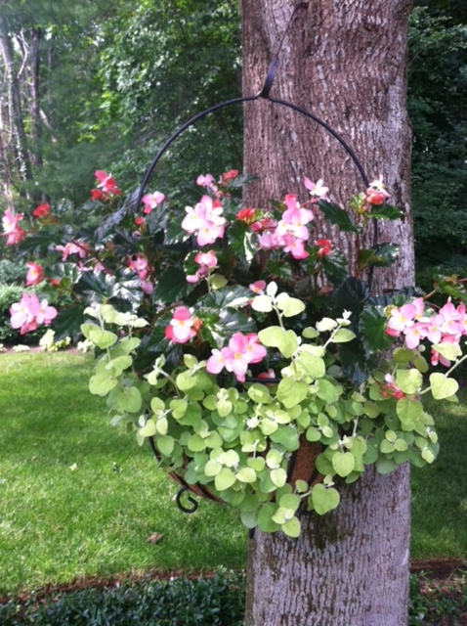
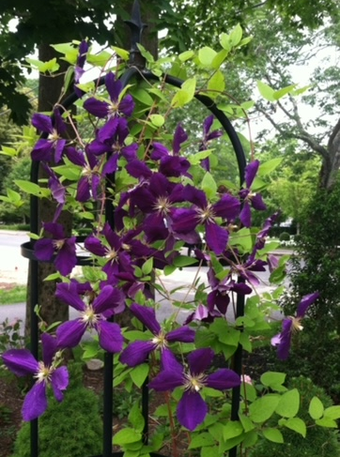
Karen Pinard
Notes:
Karen Pinard

Slide 22
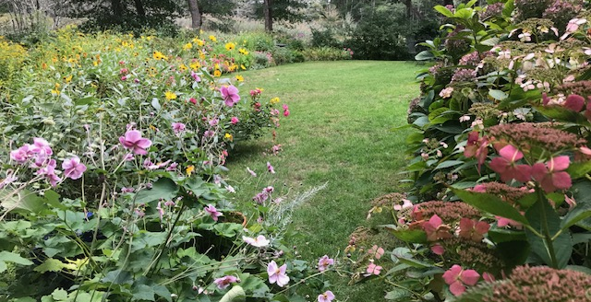
Cate Gulliver

Slide 23
Cate Gulliver

Slide 24
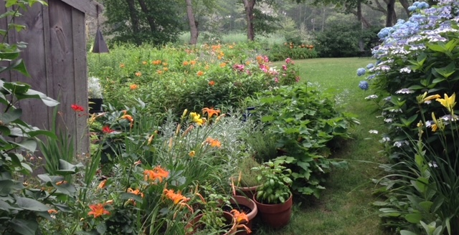
Cate Gulliver

Slide 25
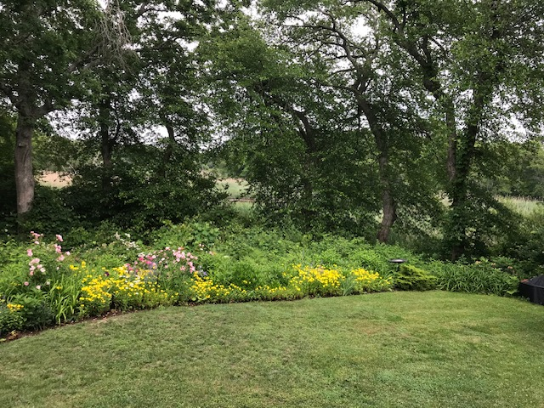
Cate Gulliver

Slide 26
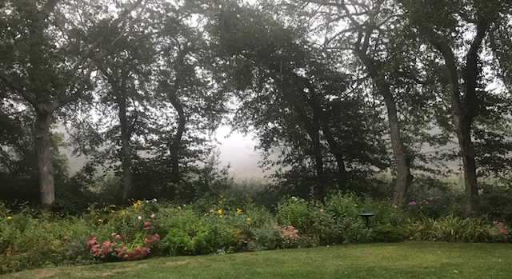
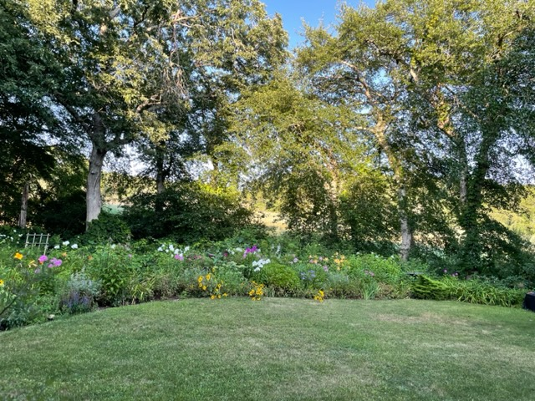
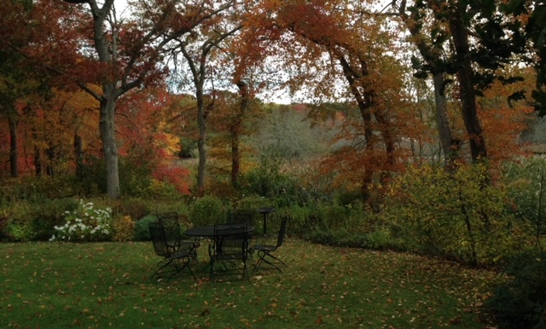
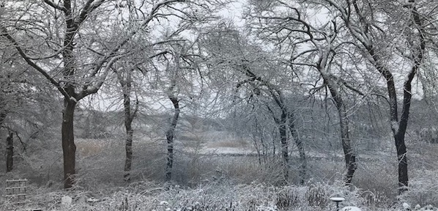
Cate Gulliver

Slide 27
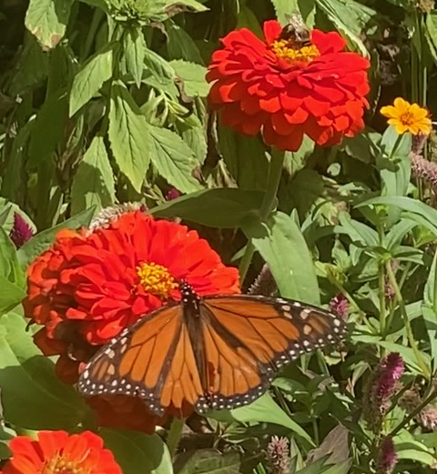
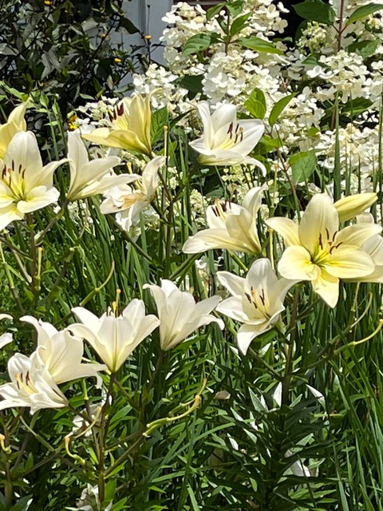
Sally Orcutt
Notes:
Sally Orcutt

Slide 28
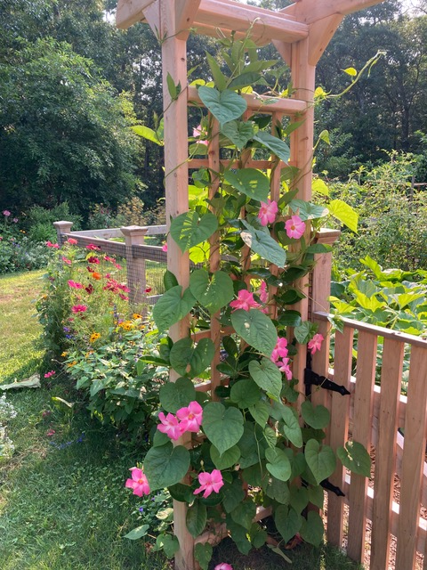
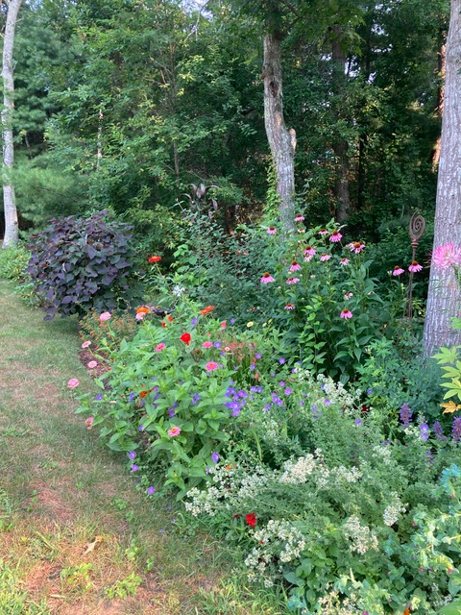
Sally Orcutt
Notes:
Sally Orcutt

Slide 29
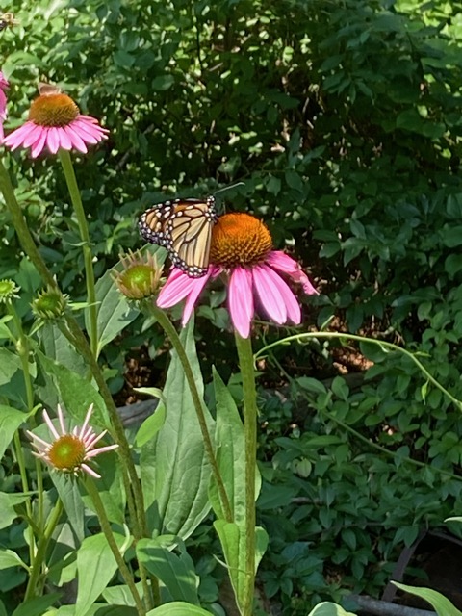
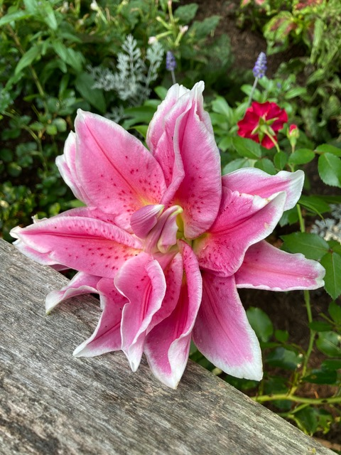
Sally Orcutt
Notes:
Sally Orcutt

Slide 30
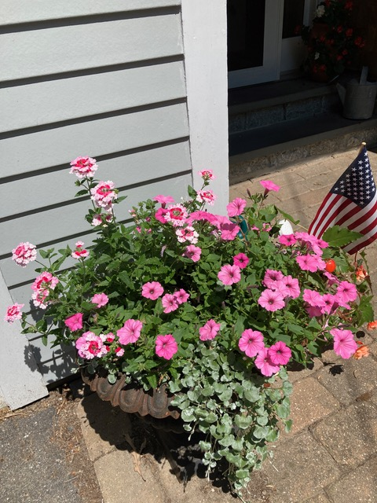
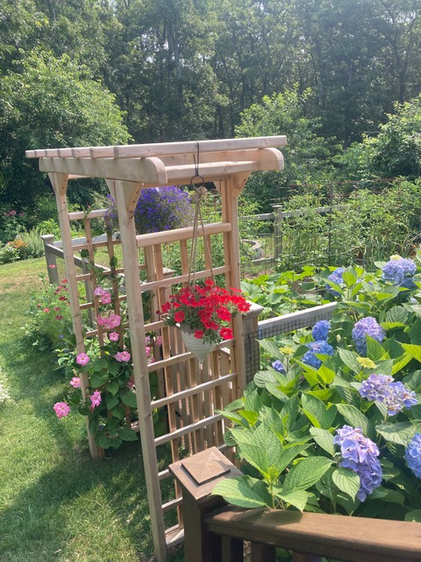
Sally Orcutt
Notes:
Sally Orcutt

Slide 31
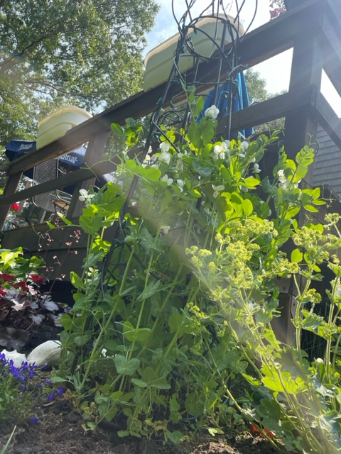
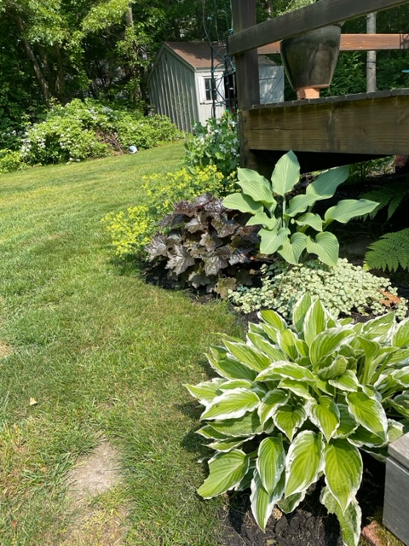
Diane Wollensak
Notes:
Diane Wollensak

Slide 32
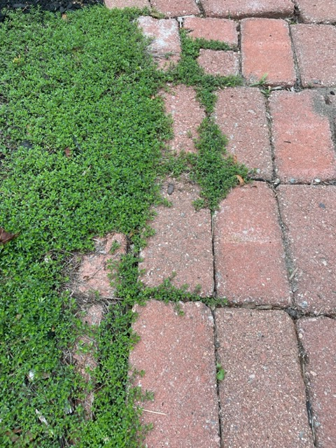
Diane Wollensak
Notes:
Creeping Thyme Diane Wollensak

Slide 33
Debbie Myers
Notes:
Rose of Sharon/Debbie Myers

Slide 34
Debbie Myers

Slide 35
Debbie Myers

Slide 36
Debbie Myers

Slide 37
Debbie Myers

Slide 38
Leslie Averna
Notes:
Martagon Lily Leslie Averna

Slide 39
Leslie Averna
Notes:
Heuchera Leslie Averna

Slide 40
Leslie Averna
Notes:
Leslie Averna

Slide 41
Leslie Averna
Notes:
Canadian Tiger Swallowtail butterfly Leslie Averna

Slide 42
Leslie Averna
Notes:
Coastal Sweet Pepper Bush Leslie Averna

Slide 43
Linda Courteau
Linda Courteau
Notes:
Linda Courteau

Slide 44
Linda Courteau
Notes:
Linda Courteau

Slide 45
Linda Courteau
Notes:
Asiatic Lily Carol Trifone

Slide 46
Linda Courteau
Linda Courteau
Notes:
Linda Courteau

Slide 47
Linda Courteau
Linda Courteau
Notes:
Linda Courteau

Slide 48
Peggy Anschultz
Peggy Anschulz
Notes:
Camelia/Euphorbia/Peggy Anschutz

Slide 49
Peggy Anschultz
Peggy Anschulz
Notes:
Camelia/Euphorbia/Peggy Anschutz

Slide 50
Betty Anne Broderick
Notes:
Echinacea Betty Anne Broderick

Slide 51
Betty Anne Broderick
Notes:
Tree Hydrangea Betty Anne Broderick

Slide 52
Betty Anne Broderick
Notes:
Nasturtiums Betty Anne Broderick

Slide 53
Betty Anne Broderick
Notes:
Betty Anne Broderick

Slide 54
Marian Nicastro
Notes:
Marian Nicastro

Slide 55
Marian Nicastro
Marian Nicastro
Notes:
Marian Nicastro

Slide 56
Marian Nicastro
Marian Nicastro
Notes:
Marian Nicastro

Slide 57
Marian Nicastro
Marian Nicastro
Notes:
Marian Nicastro

Slide 58
Marian Nicastro
Marian Nicastro
Notes:
Marian Nicastro

Slide 59
Marian Nicastro
Marian Nicastro
Notes:
Marian Nicastro

Slide 60
GeeGee Murphy

Slide 61
GeeGee Murphy

Slide 62
GeeGee Murphy

Slide 63
Sue Ellis
Notes:
Hollyhock Sue Ellis

Slide 64
Sue Ellis
Notes:
Hollyhock Sue Ellis

Slide 65
Sue Ellis
Notes:
Knock outs and petunias Sue Ellis

Slide 66
Sue Ellis
Notes:
Knockouts and catmint Sue Ellis

Slide 67
Sue Ellis
Notes:
Sue Ellis

Slide 68
Carol Lynch
Notes:
Hydrangeas Carol Lynch

Slide 69
Carol Lynch
Notes:
Echinacea Carol Lynch

Slide 70
Gail Reilly
Notes:
Gail Reilly

Slide 71
Gail Reilly
Notes:
Gail reilly

Slide 72
Susan Dewey
Notes:
Susan Dewey

Slide 73
Susan Dewey
Notes:
Susan Dewey

Slide 74
Susan Dewey
Notes:
Susan Dewey

Slide 75
Susan Dewey
Notes:
Susan Dewey

Slide 76
Susan Dewey
Notes:
Susan Dewey

Slide 77
Susan Dewey

Slide 78
Susan Dewey
Notes:
Susan Dewey

Slide 79
Jane McLaughlin

Slide 80
Jane McLaughlin

Slide 81
Jane McLaughlin

Slide 82
Jane McLaughlin

Slide 83
Thank you, friends, for sharing your beautiful gardens with us.

